Slide 1
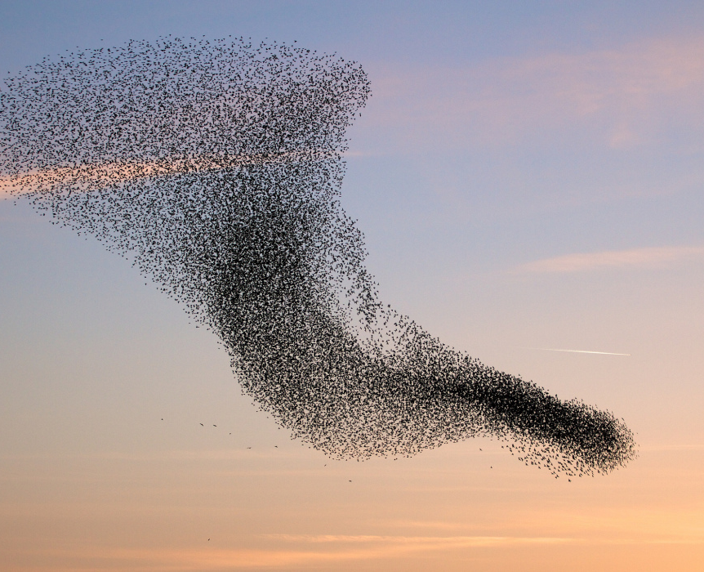
Differential Equations
Quantifying Causality

Slide 2
Vogelsberger et al. (2014). Nature.
https://www.youtube.com/watch?v=4jXVDeUHMSA&t=71s

Slide 3

$$\frac{dx}{dt}=\lim_{δt→0}\frac{x\left(t+δt\right)−x\left(t\right)}{δt}$$

Slide 4
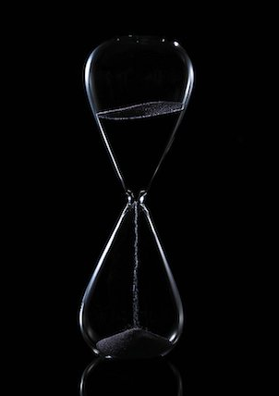


$x\left(t+δt\right)=x\left(t\right)+δt\frac{dx\left(t\right)}{dt}$
as $δt→0$
If we know the present and the derivative with respect to time, then we know the immediate future.

Slide 5
Outline of tutorial
Parts of a differential equation
Analysis of nonlinear systems (by hand)
Computer simulations of dynamical systems

Slide 6
Parts of a differential equation
The differentials
The initial conditions/boundary values
The variables
The parameters

Slide 7
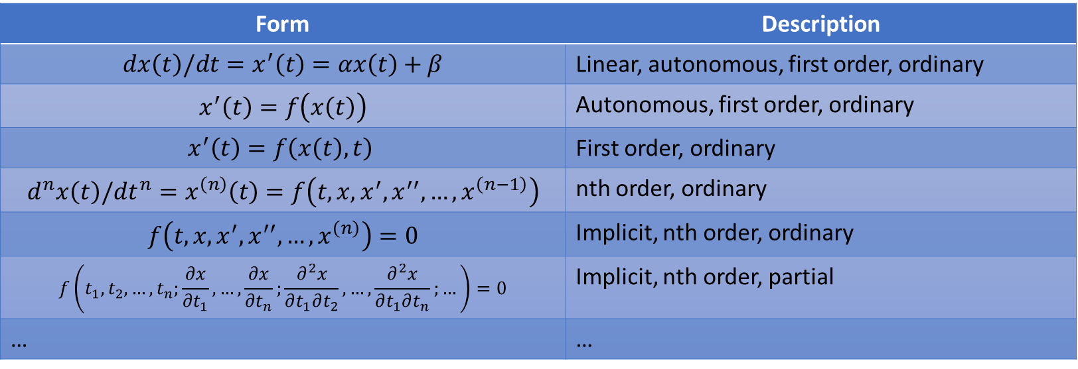
Parts of a differential equation
The differentials: order and partial/ordinary differential equation
Form | Description
$$dx\left(t\right)/dt=x^{′}\left(t\right)=αx\left(t\right)+β$$ | Linear, autonomous, first order, ordinary
$$x^{′}\left(t\right)=f\left(x\left(t\right)\right)$$ | Autonomous, first order, ordinary
$$x^{′}\left(t\right)=f\left(x\left(t\right),t\right)$$ | First order, ordinary
$$d^{n}x\left(t\right)/dt^{n}=x^{\left(n\right)}\left(t\right)=f\left(t,x,x^{′},x^{′′},…,x^{\left(n−1\right)}\right)$$ | nth order, ordinary
$$f\left(t,x,x^{′},x^{′′},…,x^{\left(n\right)}\right)=0$$ | Implicit, nth order, ordinary
$$f\left(t_{1},t_{2},…,t_{n};\frac{∂x}{∂t_{1}},…,\frac{∂x}{∂t_{n}};\frac{∂^{2}x}{∂t_{1}∂t_{2}},…,\frac{∂^{2}x}{∂t_{1}∂t_{n}};…\right)=0$$ | Implicit, nth order, partial
… | …
*These are all one dimensional. We can also form systems of coupled DEs

Slide 8
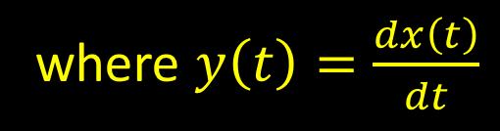

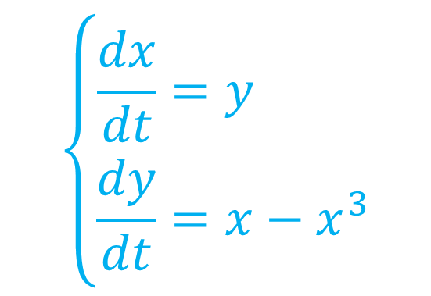
Example: 2nd order, explicit, nonlinear ODE
$$\frac{d^{2}x}{dt^{2}}=x−x^{3}$$
We can write an explicit, nth order ODE as a system of first order ODEs
$$\left\{\begin{aligned}\frac{dx}{dt}&=y \\ \frac{dy}{dt}&=x−x^{3}\end{aligned}\right.$$
where $y\left(t\right)=\frac{dx\left(t\right)}{dt}$

Slide 9
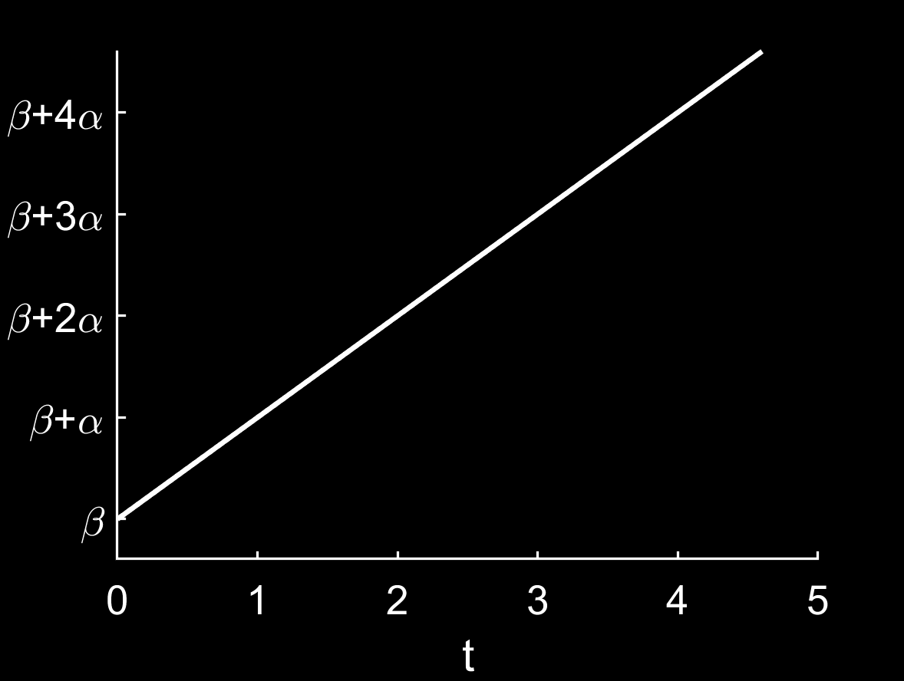
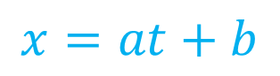
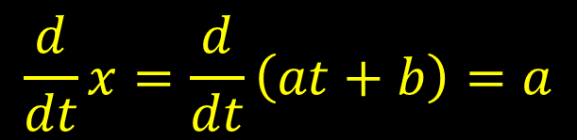



Example: 1st order, linear, explicit ODE
$$\frac{dx}{dt}=α$$
$$1$$
$$x=at+b$$
$$α$$
$$\frac{d}{dt}x=\frac{d}{dt}\left(at+b\right)=a$$

Slide 10
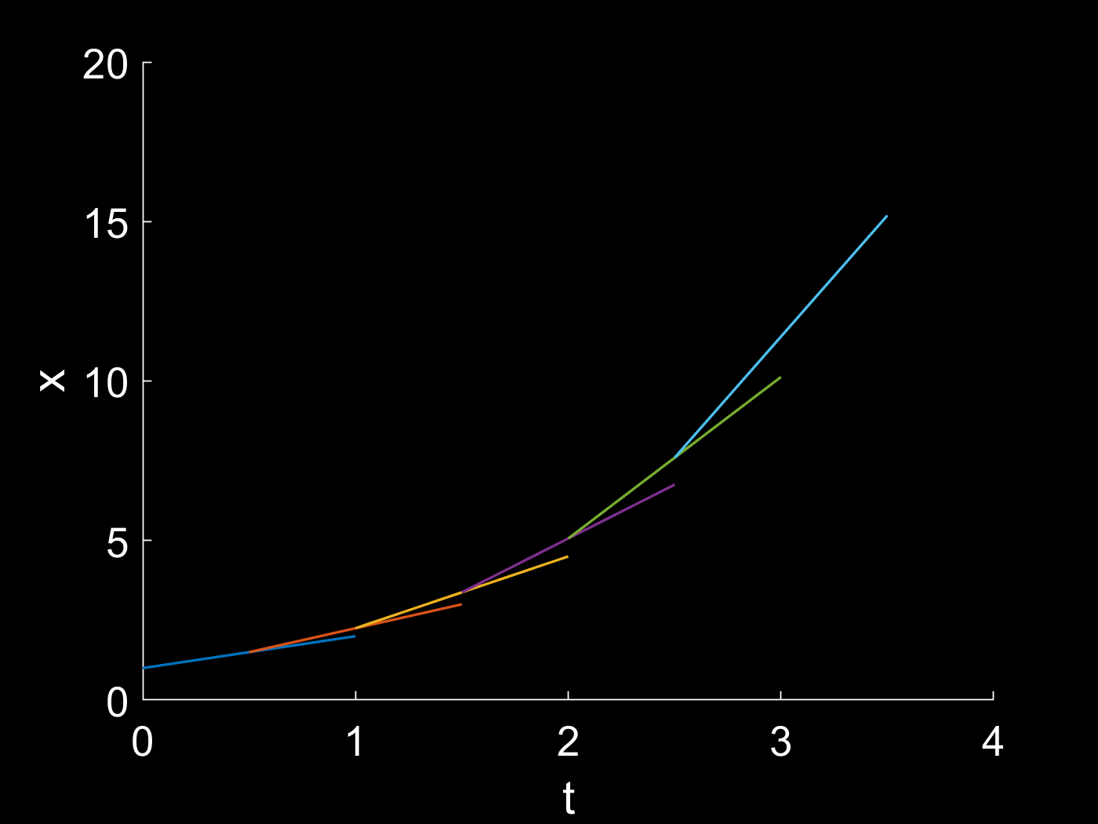
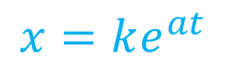

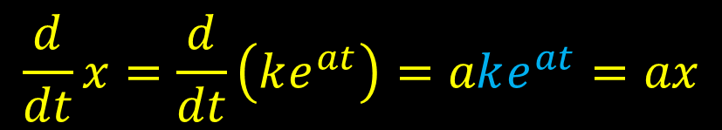
Example: 1st order, linear, explicit ODE
$$\frac{dx}{dt}=αx$$
$$x=ke^{at}$$
$$\frac{d}{dt}x=\frac{d}{dt}\left(ke^{at}\right)=ake^{at}=ax$$

Slide 11
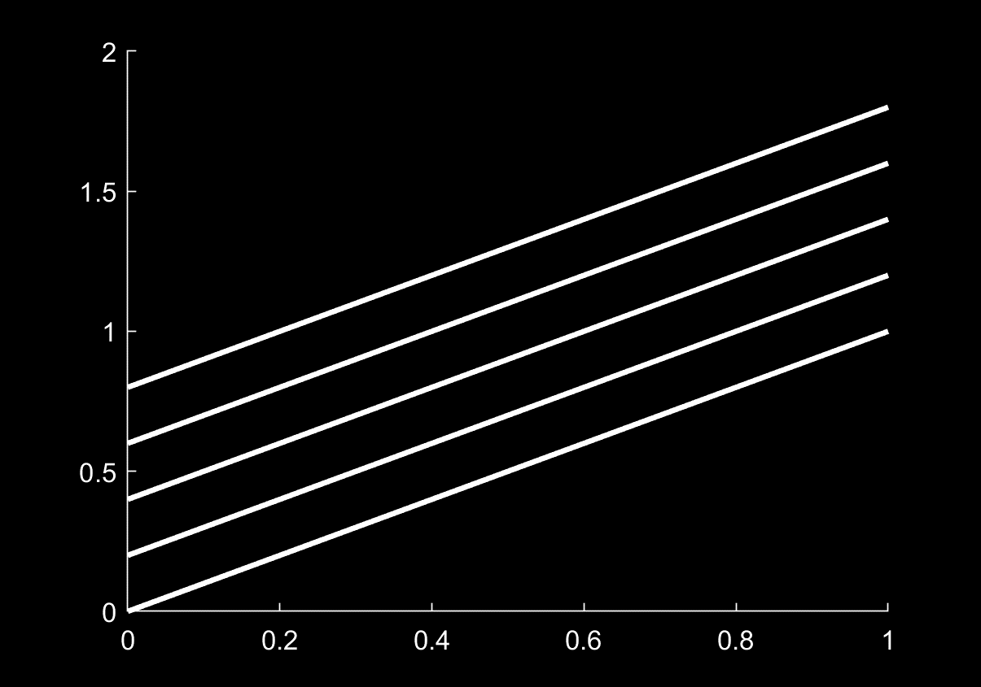

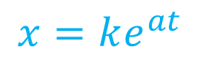
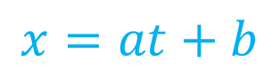



$$\frac{dx}{dt}=α$$
$$\frac{dx}{dt}=αx$$
$$x=at+b$$
$$x=ke^{at}$$
Where did these come from?
All these lines have the same slope.
They all satisfy the differential equation
$$\frac{dx}{dt}=a$$
A differential equation alone is not a well-posed problem.
$$\int_{a}^{t}{f\left(τ\right)dτ} =F\left(t\right)+C$$

Slide 12

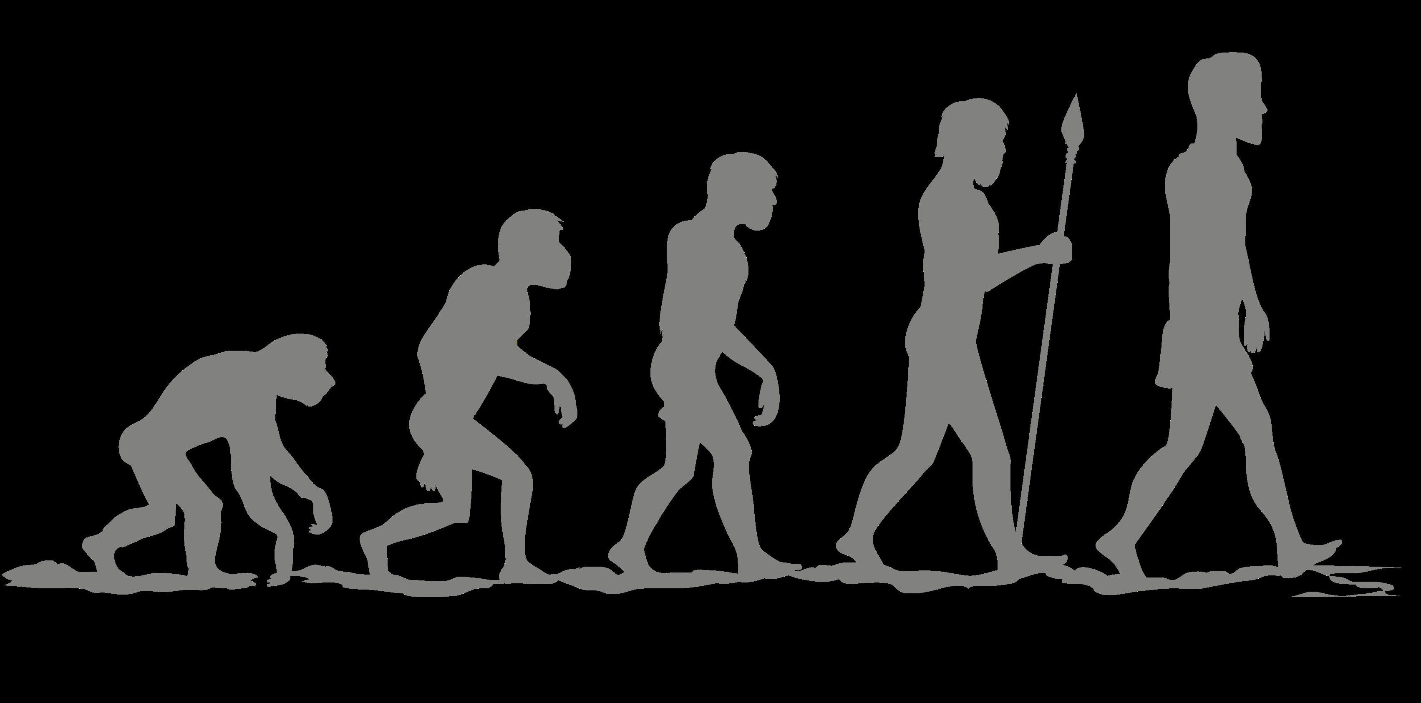
Parts of a differential equation
The differentials
The initial conditions/boundary values: where do we start?

Slide 13
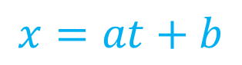
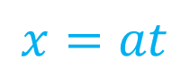

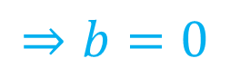
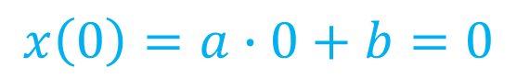

Example: Initial conditions
$$\frac{dx}{dt}=α$$
$$x\left(0\right)=0$$
$$x=at+b$$
$$x\left(0\right)=a∙0+b=0$$
$$⇒b=0$$
$$x=at$$
This is now the unique solution to our Initial Value Problem.

Slide 14

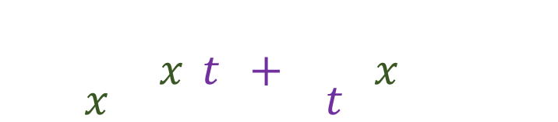
Example: Boundary Values
Video from: 3Blue1Brown. Solving the heat equation. Youtube.
$$α\frac{d^{2}T}{dx^{2}}\left(x,t\right)+\frac{dT}{dt}\left(x,t\right)=0$$
Specify behaviour on the boundary
$$T\left(x,0\right)=?$$
https://www.youtube.com/watch?v=ToIXSwZ1pJU&t=760s
PDE

Slide 15

Parts of a differential equation
The differentials
The initial conditions/boundary values
The variables: What in the universe do we want to model?
$$\frac{dx_{1}}{dt}=$$ | $$f_{1}(x_{1},x_{2},…,x_{n})$$
$$\frac{dx_{2}}{dt}=$$ | $$f_{2}(x_{1},x_{2},…,x_{n})$$
…
$$\frac{dx_{n}}{dt}=$$ | $$f_{n}(x_{1},x_{2},…,x_{n})$$

Slide 16


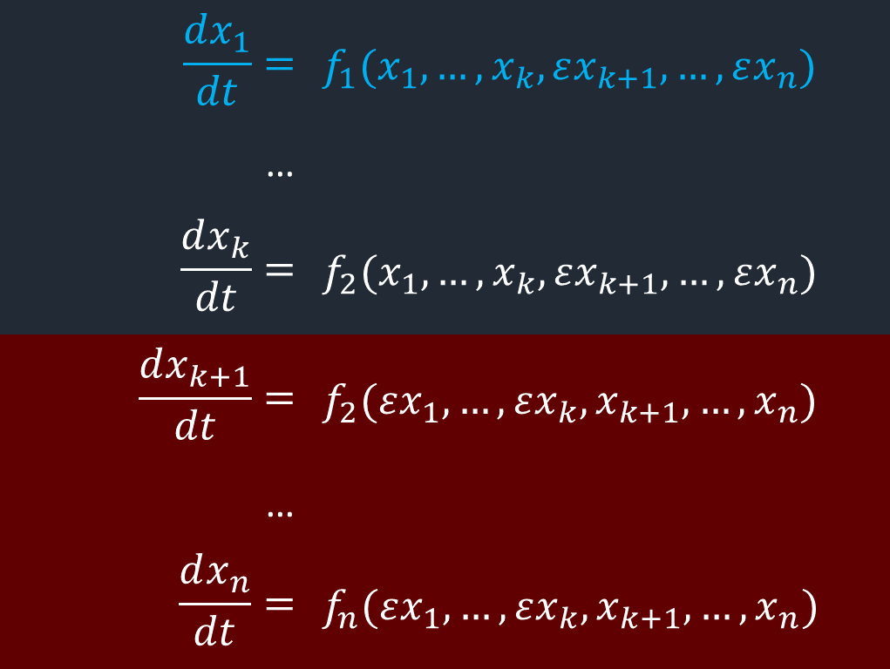


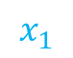
1. Interaction strength with variable of interest
$$\frac{dx_{1}}{dt}=$$ | $$f_{1}(x_{1}, …,x_{k},εx_{k+1},…,εx_{n})$$
…
$$\frac{dx_{k}}{dt}=$$ | $$f_{2}(x_{1},…,x_{k},εx_{k+1},…,εx_{n})$$
$$\frac{dx_{k+1}}{dt}=$$ | $$f_{2}(εx_{1},…,εx_{k},x_{k+1},…,x_{n})$$
…
$$\frac{dx_{n}}{dt}=$$ | $$f_{n}(εx_{1},…,εx_{k},x_{k+1},…,x_{n})$$
$$x_{1}$$
$$x_{2}$$
$$x_{3}$$
$$ε$$

Slide 17
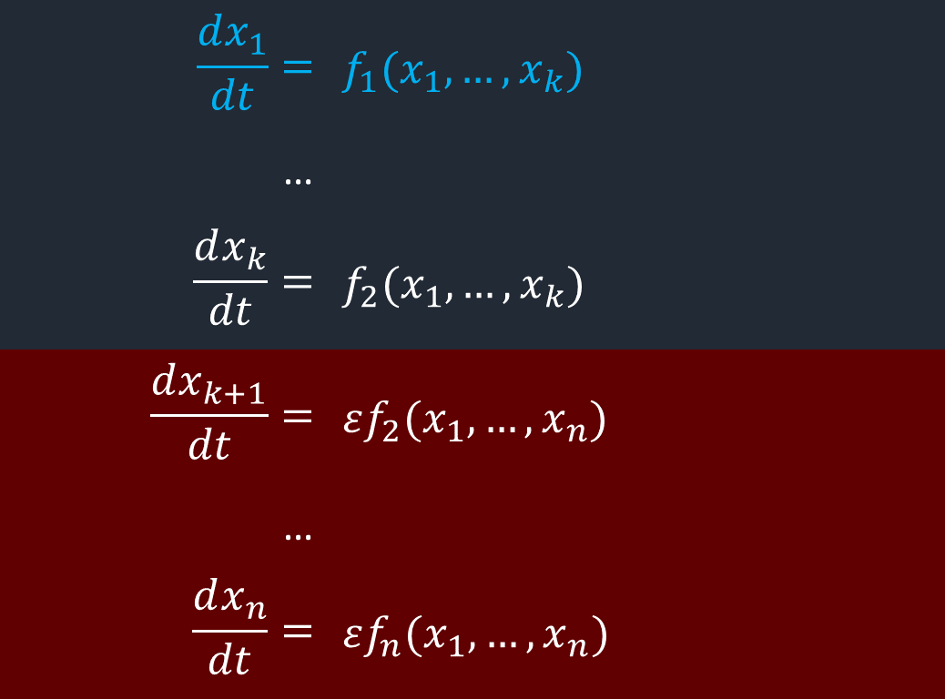
2. Time scales: some variables are parameters relative to our variable of interest
$$\frac{dx_{1}}{dt}=$$ | $$f_{1}(x_{1}, …,x_{k})$$
…
$$\frac{dx_{k}}{dt}=$$ | $$f_{2}(x_{1},…,x_{k})$$
$$\frac{dx_{k+1}}{dt}=$$ | $$εf_{2}(x_{1},…,x_{n})$$
…
$$\frac{dx_{n}}{dt}=$$ | $$εf_{n}(x_{1},…,x_{n})$$
Quasi-steady-state approximation (QSSA)
Multiple scale (fast/slow) analysis

Slide 18
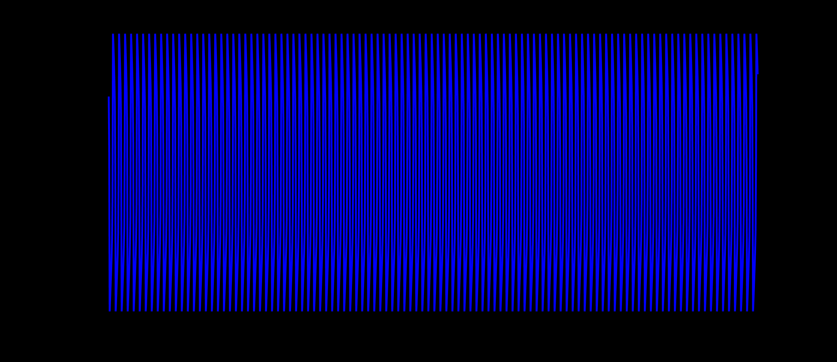
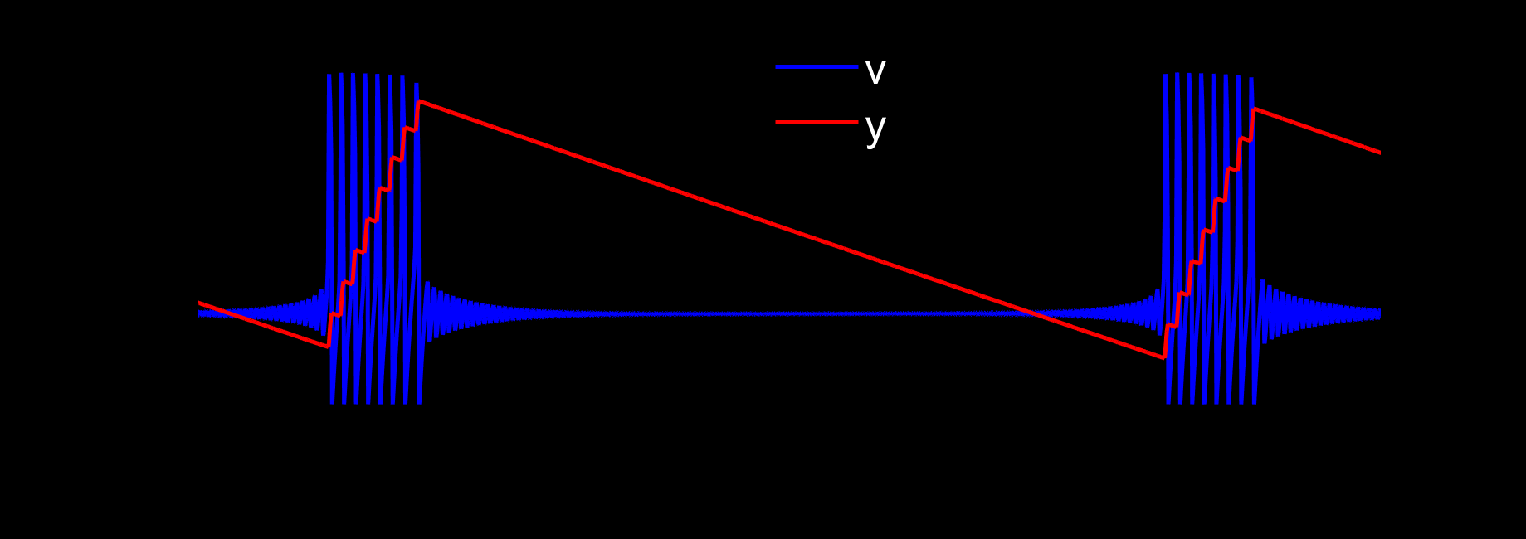
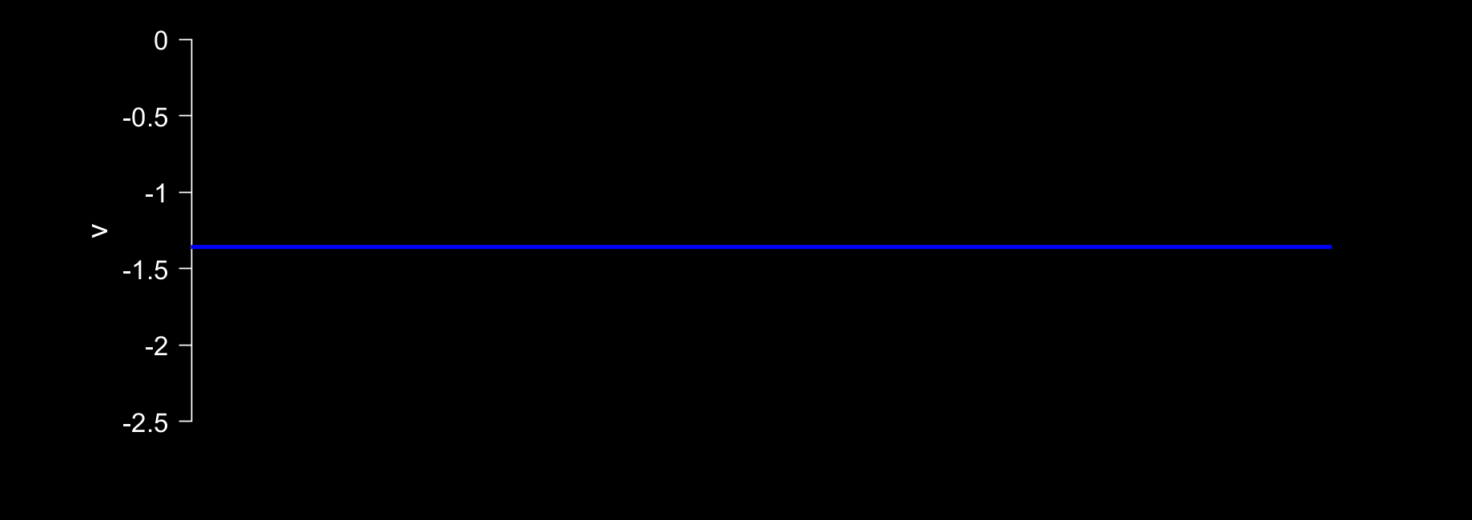
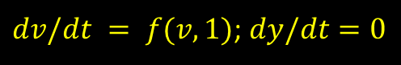
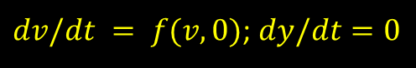
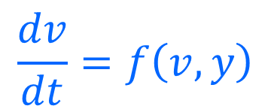
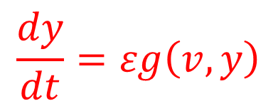
Example: fast/slow system
Analyzing the fast subsystem
$$\frac{dv}{dt}=f\left(v,y\right)$$
$$\frac{dy}{dt}=εg\left(v,y\right)$$
$dv/dt = f(v,0)$; $dy/dt=0$
$dv/dt = f(v,1)$; $dy/dt=0$

Slide 19




Parameters: units must make sense!
Suppose x is a length. Then dx/dt is units of [length] ∙ [time]⁻¹
$$\frac{dx}{dt}=αx+βx^{2}+γ$$
$[γ]$ = [length] ∙ [time]⁻¹
$[α]$ = [time]⁻¹
$[β]$ = [length]⁻¹ ∙ [time]⁻¹

Slide 20
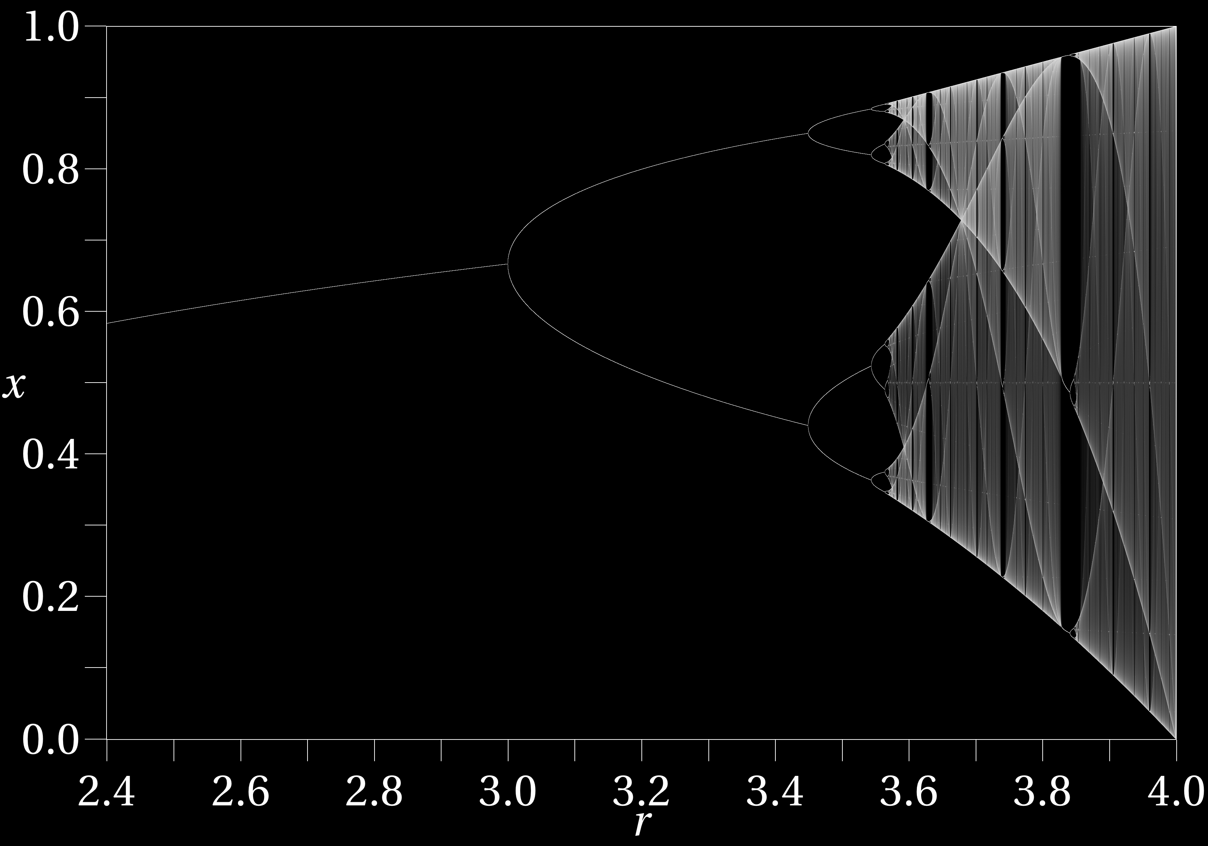
Analysing nonlinear ODEs
Phase space portrait
Linear stability analysis
Bifurcation analysis

Slide 21
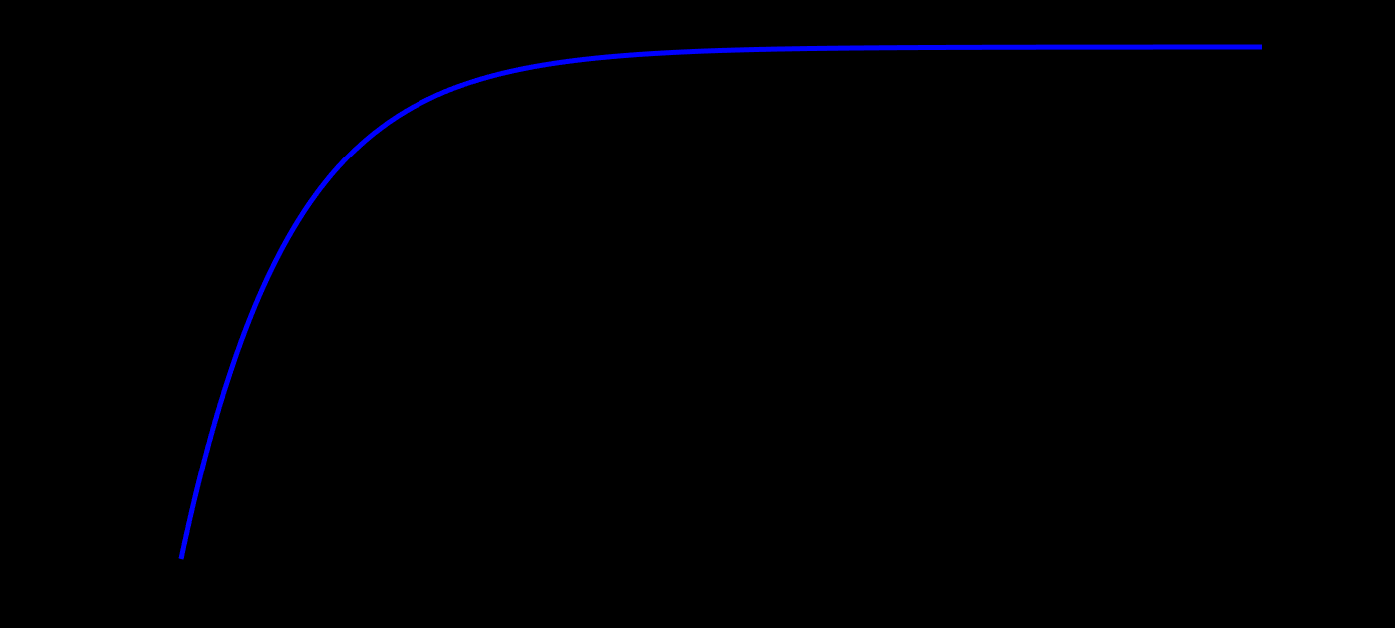



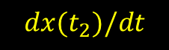
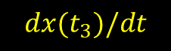






Phase space: Let’s forget about time…
$$dx(t_{3})/dt$$
$$dx(t_{2})/dt$$
$\frac{dx}{dt}=x−x^{2}$ only depends on x. Therefore, the differential equation defines a vector field over the domain of x.
$$x=0$$
$$x=1$$
$$x=2$$
$$dx(t_{1})/dt$$
All roads lead to $x=1$...
$$x(t)$$
We call x=1 an equilibrium, steady-state, or fixed point of the system.
$$t$$

Slide 22
Phase space doesn’t depend on time or initial conditions. Here, we can analyze the structure underlying the behaviour of the system.

Slide 23



Phase space: two dimensions
Consider the system:
$$\frac{dx}{dt}=x+e^{−y}$$
$$\frac{dy}{dt}=−y$$
$\frac{dy}{dt}=0$ when $y=0$, but $\frac{dx}{dt}≠0$.
We call this the y-nullcline. What is the x-nullcline?

Slide 24
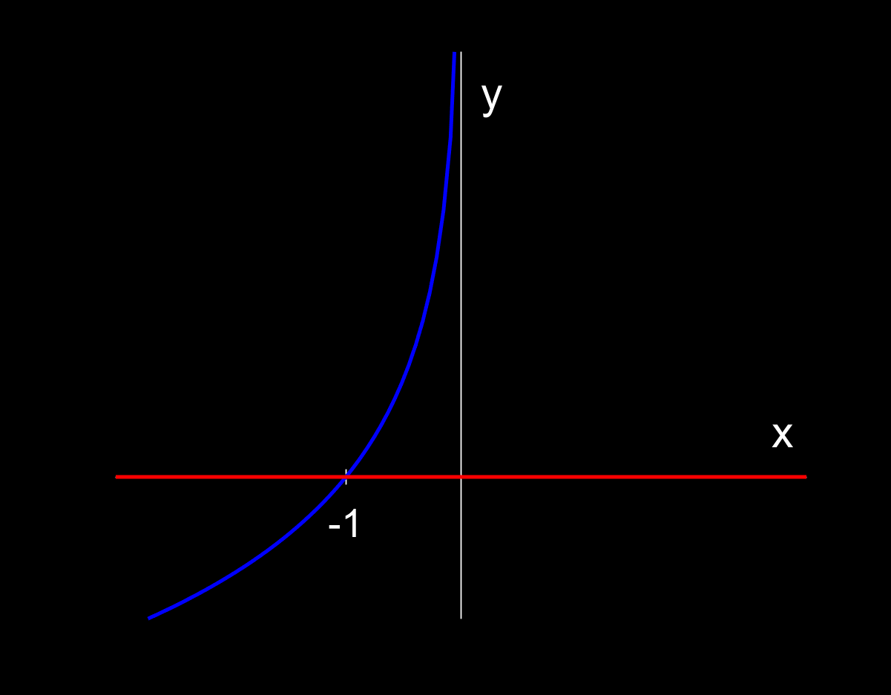

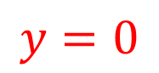
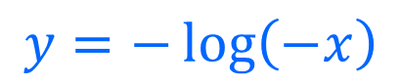
Phase space: two dimensions
x-nullcline
Consider the system:
$$\frac{dx}{dt}=x+e^{−y}$$
$$y=−\log\left(−x\right)$$
$$\frac{dy}{dt}=−y$$
y-nullcline
$$y=0$$
At $\left(−1,0\right)$ both $\frac{dx}{dt}=0$ and $\frac{dy}{dt}=0$
Our system is at equilibrium when nullclines intersect

Slide 25
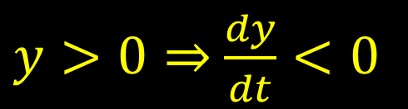
Phase space: two dimensions
x-nullcline
Consider the system:
$$\frac{dx}{dt}=x+e^{−y}$$
$$y=−\log\left(−x\right)$$
$$\frac{dy}{dt}=−y$$
y-nullcline
$$y=0$$
$y>0⇒$ $\frac{dy}{dt}<0$

Slide 26
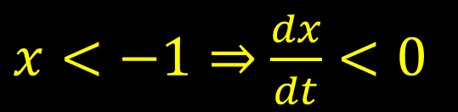
Phase space: two dimensions
x-nullcline
Consider the system:
$$\frac{dx}{dt}=x+e^{−y}$$
$$y=−\log\left(−x\right)$$
$$\frac{dy}{dt}=−y$$
y-nullcline
$$y=0$$
$y>0⇒$ $\frac{dy}{dt}<0$
$x<−1⇒$ $\frac{dx}{dt}<0$

Slide 27
Phase space: two dimensions
x-nullcline
Consider the system:
$$\frac{dx}{dt}=x+e^{−y}$$
$$y=−\log\left(−x\right)$$
$$\frac{dy}{dt}=−y$$
y-nullcline
$$y=0$$
$y>0⇒$ $\frac{dy}{dt}<0$
$x<−1⇒$ $\frac{dx}{dt}<0$

Slide 28
Phase space: two dimensions
x-nullcline
Consider the system:
$$\frac{dx}{dt}=x+e^{−y}$$
$$y=−\log\left(−x\right)$$
$$\frac{dy}{dt}=−y$$
y-nullcline
$$y=0$$
Why are the trajectories going away from the steady state?
$y>0⇒$ $\frac{dy}{dt}<0$
$x<−1⇒$ $\frac{dx}{dt}<0$

Slide 29

Linear stability analysis
What happens when you push a system away from equilibrium?
$$\frac{dx_{1}\left(t\right)}{dt}=$$ | 0
$$\frac{dx_{2}\left(t\right)}{dt}=$$ | 0
…
$$\frac{dx_{n}\left(t\right)}{dt}=$$ | 0
This system is not evolving anymore, i.e. it is at equilibrium.

Slide 30
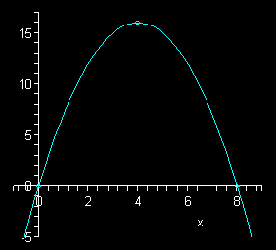
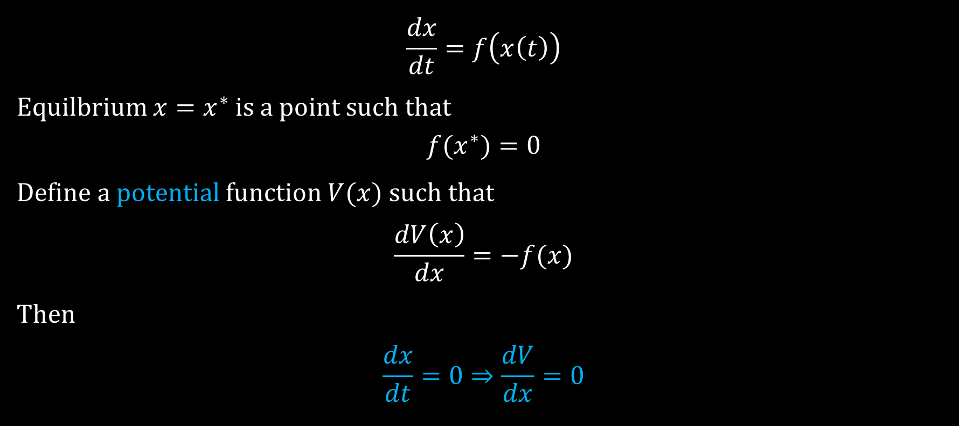

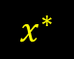
Linear stability analysis
One dimensional system
$$\frac{dx}{dt}=f\left(x\left(t\right)\right)$$
Equilbrium $x=x^{∗}$ is a point such that
$$f(x^{∗})=0$$
Define a potential function $V(x)$ such that
$$\frac{dV\left(x\right)}{dx}=−f(x)$$
Then
$$\frac{dx}{dt}=0⇒\frac{dV}{dx}=0$$
$$V(x)$$
$$x^{∗}$$

Slide 31
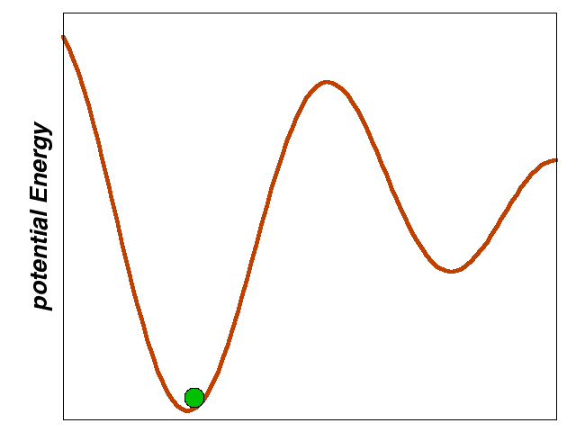

Linear stability analysis
One dimensional system
Stability depends on whether the potential is at a local minimum or maximum
The second derivative test from calculus
If $\frac{d^{2}V}{dx^{2}}\left(x^{∗}\right)<0$ then the equilibrium is a maximum
If $\frac{d^{2}V}{dx^{2}}\left(x^{∗}\right)>0$ then the equilibrium is a minimum
If $\frac{d^{2}V}{dx^{2}}\left(x^{∗}\right)=0$ then the equilibrium is a saddle

Slide 32

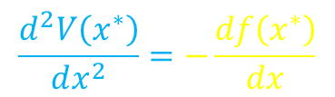
Linear stability analysis
One dimensional system
$$\frac{d^{2}V\left(x^{∗}\right)}{dx^{2}}=−\frac{df\left(x^{∗}\right)}{dx}$$
$\frac{df}{dx}\left(x^{∗}\right)>0$ then the equilibrium is a unstable
$\frac{df}{dx} \left(x^{∗}\right)<0$ then the equilibrium is a stable
$\frac{df}{dx} \left(x^{∗}\right)=0$ then the equilibrium is a “saddle”

Slide 33
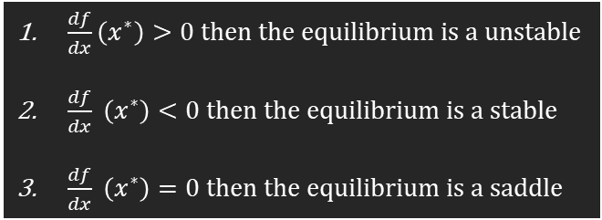

Linear stability analysis: exercise
$\frac{df}{dx}\left(x^{∗}\right)>0$ then the equilibrium is a unstable
$\frac{df}{dx} \left(x^{∗}\right)<0$ then the equilibrium is a stable
$\frac{df}{dx} \left(x^{∗}\right)=0$ then the equilibrium is a saddle
$$\frac{dx}{dt}=x−x^{3}$$
For what values of x is dx/dt = 0? (Hint there are 3).
Draw the potential function for this system.
For each equilibrium, is it stable or unstable?

Slide 34
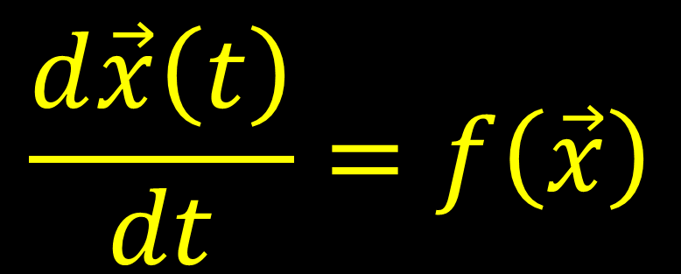



Higher dimensions: notation for system
$$\frac{d\vec{x}\left(t\right)}{dt}=f\left(\vec{x}\right)$$
$$\frac{dx_{1}\left(t\right)}{dt}=$$ | $$f_{1}\left(x_{1},…,x_{n}\right)$$
$$\frac{dx_{2}\left(t\right)}{dt}=$$ | $$f_{2}\left(x_{1},…,x_{n}\right)$$
…
$$\frac{dx_{n}\left(t\right)}{dt}=$$ | $$f_{n}\left(x_{1},…,x_{n}\right)$$
$$f\left(\vec{x}\right)=\left(\begin{matrix}f_{1}\left(\vec{x}\right) \\ ⋮ \\ f_{n}(\vec{x})\end{matrix}\right)$$
$$\vec{x}=\left(\begin{matrix}x_{1} \\ ⋮ \\ x_{n}\end{matrix}\right)$$

Slide 35
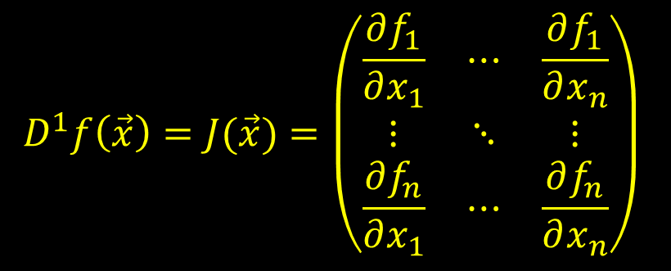
Linear stability analysis
Analogous to one dimension, except instead of looking at the sign of the first derivative, we look at the eigenvalues of the “generalized first derivative,” i.e. the Jacobian Matrix.
$$D^{1}f\left(\vec{x}\right)=J(\vec{x})={\left(\begin{matrix}\frac{∂f_{1}}{∂x_{1}} & ⋯ & \frac{∂f_{1}}{∂x_{n}} \\ ⋮ & ⋱ & ⋮ \\ \frac{∂f_{n}}{∂x_{1}} & ⋯ & \frac{∂f_{n}}{∂x_{n}}\end{matrix}\right)}_{ }$$

Slide 36
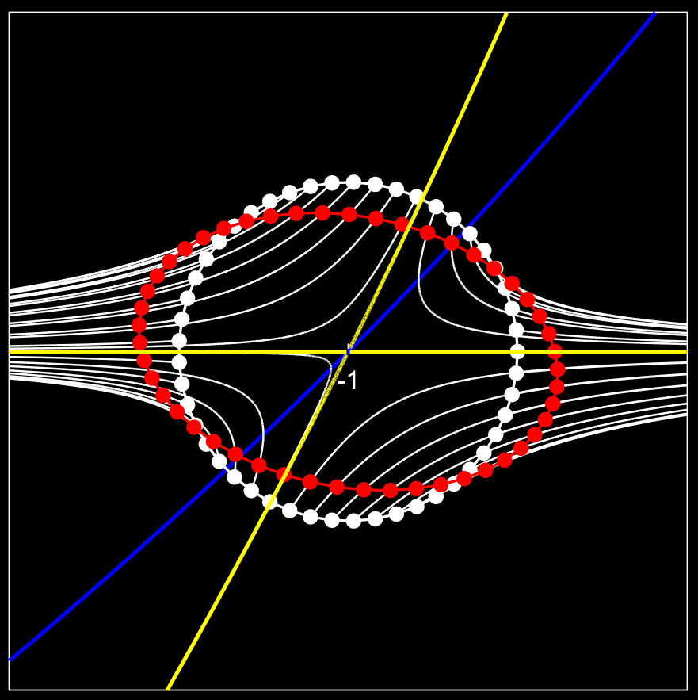

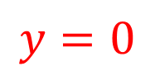
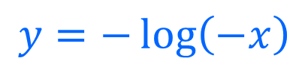

Intuition #1
$$\frac{dx}{dt}=x+e^{−y}$$
x-nullcline
$$\frac{dy}{dt}=−y$$
$$y=−\log\left(−x\right)$$
The eigenvectors and eigenvalues of the Jacobian tell us how a circle around the fixed will deform under our differential equations.
y-nullcline
$$y=0$$

Slide 37
Intuition #1
$$\frac{dx}{dt}=x+e^{−y}$$
x-nullcline
$$\frac{dy}{dt}=−y$$
$$y=−\log\left(−x\right)$$
This is analogous to how the eigenvectors of a correlation matrix tells us the direction of maximum variance when using PCA.
y-nullcline
$$y=0$$

Slide 38



Intuition #2
Similar to one dimension, the Jacobian matrix of the system can be thought of as the Hessian Matrix (generalized second derivative) of the potential function. So the eigenvalues of the Jacobian is analogous to an n-dimensional second-derivative test.
z
y
x
An nth dimensional system doesn’t necessarily have a potential function (only if the Jacobian is symmetric). However, intuitively, we can still imagine a local potential energy manifold which is at a maximum or minimum.
$$\left(x^{∗},y^{∗}\right)$$

Slide 39

Generalized nth derivative
Let’s not go there….we don’t need them anyways

Slide 40





Eigendecomposition
$$A=\left(\begin{matrix}a_{11} & ⋯ & a_{1n} \\ ⋮ & ⋱ & ⋮ \\ a_{n1} & ⋯ & a_{nn}\end{matrix}\right)$$
The eigenvalues $λ_{1},λ_{2},…,λ_{n}$ are all the values that satisfy the following equation:
$$\det\left(A−Iλ \right)=0$$
Example: two dimensions
$$A=\left(\begin{matrix}a_{11} & a_{12} \\ a_{21} & a_{22}\end{matrix}\right)$$
$$A−Iλ=\left(\begin{matrix}a_{11}−λ & a_{12} \\ a_{21} & a_{22}−λ\end{matrix}\right)$$
If the real part of the eigenvalue is negative, the direction is stable
If the real part of the eigenvalue is positive, the direction is unstable.
If there is an imaginary component, trajectories spiral.
$$\det\left(A−Iλ\right)=\left(a_{11}−λ\right)\left(a_{22}−λ\right)−a_{21}a_{12}$$
$$λ^{2}−\left(a_{11}+a_{22}\right)λ−a_{21}a_{12}=0$$

Slide 41




Phase space: two dimensions
x-nullcline
$$y=−\log\left(−x\right)$$
y-nullcline
$$\frac{dx}{dt}=x+e^{−y}$$
$$y=0$$
Consider the system:
$$\frac{dy}{dt}=−y$$
Let’s compute the stability of the steady-state
$$\left(x,y\right)=\left(−1 ,0\right)$$
Find Jacobian Matrix
Evaluate at steady-state
Calculate eigenvalues

Slide 42



Phase space: two dimensions
x-nullcline
$$y=−\log\left(−x\right)$$
y-nullcline
$$\frac{dx}{dt}=x+e^{−y}$$
$$y=0$$
Consider the system:
$$\frac{dy}{dt}=−y$$
$$J={\left(\begin{matrix}1 & −e^{−y} \\ 0 & −1\end{matrix}\right)}_{x=−1, y=0}$$
$$λ_{+}=1, V_{+}=\left(\begin{matrix}1 \\ 0\end{matrix}\right)$$
$$λ_{−}=−1, V_{−}=−\left(\begin{matrix}1 \\ 2\end{matrix}\right)$$

Slide 43

Phase space: two dimensions
x-nullcline
$$y=−\log\left(−x\right)$$
y-nullcline
$$\frac{dx}{dt}=x+e^{−y}$$
$$y=0$$
Consider the system:
$$\frac{dy}{dt}=−y$$
In n dimensions, an equilibrium has n stable/unstable manifolds.
Their direction is determined by the eigenvector.
Their stability is determined by the eigenvalue.

Slide 44

Bifurcation Analysis
How does the stability of a system change with a parameter?
Exercise:
$$\frac{dx}{dt}=rx−x^{2}$$
For what values is dx/dt = 0?
What is the stability of each of these steady-states?

Slide 45






Bifurcation Analysis: transcritical
stable
$$\frac{dx}{dt}=rx−x^{2}$$
unstable
$$x=r<0$$
$$x=0$$
$$x=r=0$$
$$x=0$$
$$x=r>0$$

Slide 46

Bifurcation Diagram: transcritical
$$\frac{dx}{dt}=rx−x^{2}$$
Stable
Unstable

Slide 47




Computer Simulations of ODEs
Numerical methods
Assignment
$x\left(t+δt\right)=x\left(t\right)+δt\frac{dx\left(t\right)}{dt}$
as $δt→0$
Computers have finite precision so we can never take $δt→0$ in a simulation. Numerical methods allow us to control our computation error.

Slide 48




Solving ODEs numerically: Forward Euler
Recall:
$x\left(t+δt\right)=x\left(t\right)+δt\frac{dx\left(t\right)}{dt}$
as $δt→0$
Given a step size, h, we can approximate the solution to the problem
$$\frac{dx}{dt}=f\left(t,x\right), x\left(0\right)=x_{0}$$
$$x_{n+1}←x_{n}+hf(t_{n},x_{n})$$

Slide 49
Example: 1st order, linear, explicit ODE
$$\frac{dx}{dt}=αx$$
$$x=ke^{at}$$
$$\frac{d}{dt}x=\frac{d}{dt}\left(ke^{at}\right)=ake^{at}=ax$$

